Slide 1
YouTube Trendiness Dashboard
An analysis that goes over historical data of trendiness of various genres of videos on YouTube through several main regions around the world including the US.
Disclaimer: All the visualizations in the presentation ahead are taken from the dashboard I’ve built with Tableau Public using the data that was extracted locally from the database managed by the data engineers of the Sterling & Draper advertising agency.

Slide 2

Writer’s Note
A few general notes before we begin:
The recorded time period of the used data lasted from November 18th 2017 - June 16th 2018, a time period of a total of 210 days (i.e. Nearly 8 months).
This following presentation is featured in 2 formats – ¹PowerPoint & ²PDF. The ¹PowerPoint version’s attached plots are fully interactive within the presentation, as they are connected to the original Tableau dashboard (Reference to online dashboard >>). However, be aware that the ²PDF version will lack that interactivity.
Guidance instructions for using the interactive plots inside the presentation
In order to activate interactivity: Left-click on the chart once within a slide
Use the button to reset a chart to its original form.
Use the filters to explore different comparisons of the data that would be visualized in the following charts.
The project was created as part of Practicum’s Data Analyst’s program.

Slide 3
General Findings
Entertainment is the most trendy video content genre in all countries but Russia, where it drops to the 3rd place in favor of the People & Blogs and News & Politics genre.
Most of the rather rare genres that have a lower amount of videos are like that because of seasonality, like the Nonprofits & Activism and Shows genres (who are more likely to be filmed in weekends), Gaming (on vacations), Science & Technology (on fixed time periods to test something), etc, etc…
Japan is the least diverse nation in terms of a variety of different video content genres. France’s the most varied nation in terms of control over more genres.
Russia & the USA have almost completely opposite genre preferences, besides a small amount of very minor genres. Russians prefer more serious content (News, Politics, Personas…) while Americans prefers the more entertaining content (Entertainment, Music, Comedy…).
France & India are tied or close to being tied in most of the genres they don’t lead, which could hint of a mildly similar taste in video content genres.

Slide 4
Chapter 1 – Historical trendiness
We’ve plotted the history of all the categorical variety of videos genres trendiness which were published in YouTube in the recorded time period in which the data was recorded on.
The “trendiness” of the different genres was illustrated in two ways:
A stacked area chart that visualized the absolute values of each genre’s amount of videos released throughout time. ELI5: Each genre’s value at a certain date represents the amount of the videos from the related genre that were released in the same day, and the total videos available in a certain date is the highest Y-axis value on the date (as genres are presented as slices of the whole).
A stacked-area chart that visualized the relative values of each genre’s share of all YouTube videos that were released at that same date from all genres. ELI5: Each genre is represented by it’s percentage of the total amount of videos in a date from all genres. As some genres’ percentages rise, others falls in accordance.

Slide 5
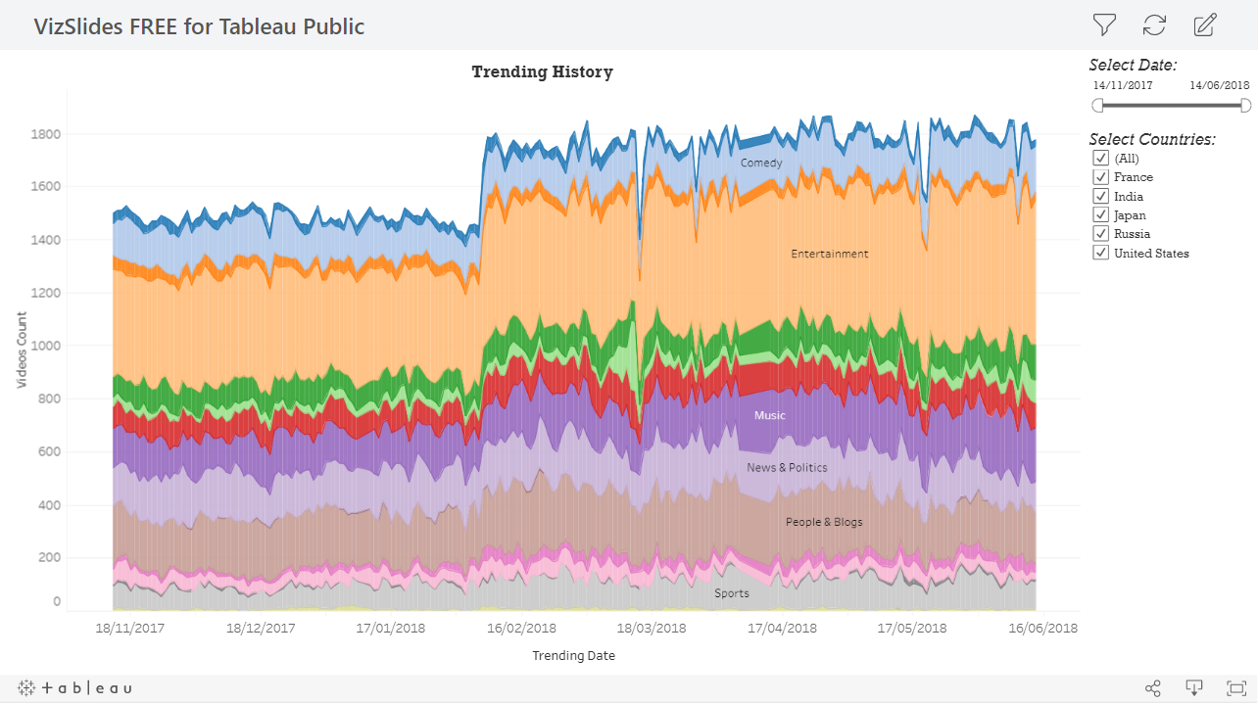
The most consistent & trendy genre was Entertainment
Historical trendiness
The Entertainment genre was the most consistent genre to be the trendiest the longest time in a row (having around 450-500 videos in any given date).
The USA’s most consistent video genres in YouTube after Entertainment were Music & Comedy. On the other hand, the trendiest genres (after Entertainment) were Music, How-to & Style, and Comedy.
A sudden rise in the total amount of videos in YouTube is seen between February 6th –February 8th 2018. After some exploration it appears that data of YouTube videos in Japan has started to be collected only from the 7th of February, meaning a whole new region has joined in a heartbeat, explaining the high rise in videos amounts from all genres. A second explanation might be other events which took place at the time - a 6.0 magnitude earthquake has struck Hualien County, Taiwan, causing a big number of casualties. It could be that many people who were at the region uploaded videos of the event as it manifested in that time period, causing that sudden rise, since the region of Japan was the primary region that caused the massive rise (e.g. Filter Japan out to see).

Slide 6
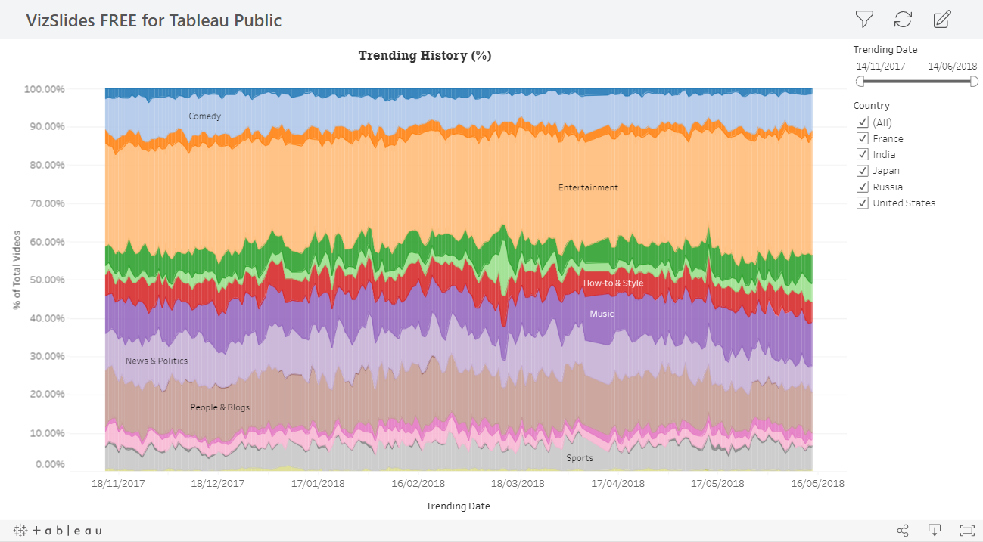
Entertainment videos averagely constitutes of nearly 30% of YouTube, followed by People & Blogs (~12.5%), News & Politics (~10%)
Historical trendiness
Genres were pretty consistent in all other regions prior to Japan joining the data collection at February 7th 2018 as genres “close-to-fixed” shares of the market start to have trembles afterwards, hinting Japan might have different trends than the other regions. The Entertainment genre is still the trendiest & most consistent, whilst Science & Technology, Education appears and disappears in distanced & correlating times, while Auto & Vehicles, Gaming, Film & Animation, and Music trend constantly, but first appearing only since the 9th in July. All these facts suggest that YouTubers in Japan record similar materials on similar period, possibly because of actualist events or holidays happening in the region.
Weekend genres: The Nonprofits & Activism has a really small share of closely 0.14% from the total amount around the globe & 0.5% in the USA when it appears indiscriminately, whilst the Shows genre (around 0.5% globally) who also appears in similar gaps might also be connected to weekends, as shows and protests usually take place at weekends, when people don’t work.
The Entertainment genre is the strongest at India (around ~43% averagely) and weakest in Russia (~20% avg.). Hence, In Russia the trendiest genres are actually the People & Blogs and News & Politics genres.
In the USA, the News & Politics are deteriorating in amount towards the Summer, while alternatively the Gaming genre is rising in trendiness

Slide 7
Chapter 2 – Geographical effects over trendiness
The next plots were visualized to explore the relation of the geographical location to trendiness.
The “trendiness” of these different regions was illustrated in two ways:
A pie chart exploring trending videos by country.
A highlight table showing the distribution of videos from each genre between various countries.

Slide 8
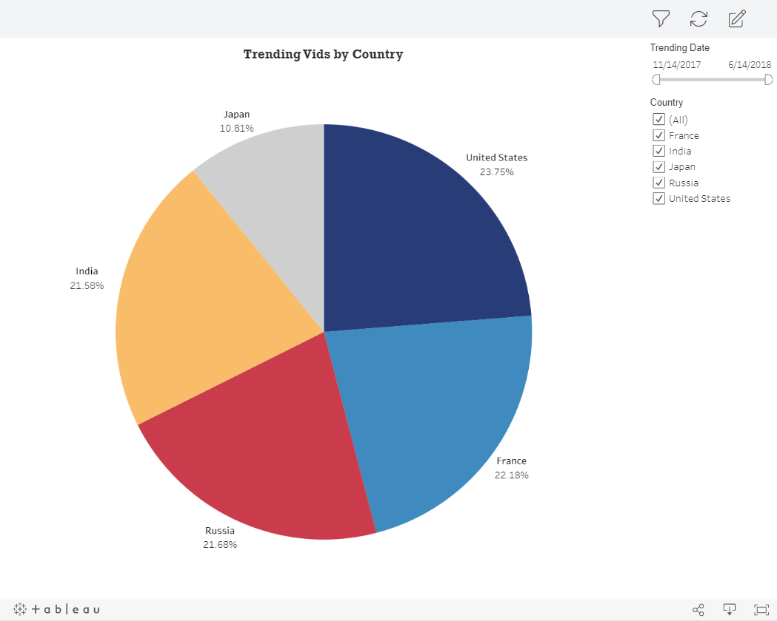
Japan creates the smallest amount of YouTube videos because they had half the time all other nations had
Geographical effects over trendiness
The United States creates the biggest amount of YouTube content.
Before Japan’s data has started to be collected too, all other 4 regions represented close to a full quarter of all YouTube’s content, while all countries but the USA had a share that is smaller than a full quarter by up to -0.93% percents.
After Japan’s data has started to be collected, Japan’s content has constituted of almost 17% of all YouTube’s video content. By comparing that share to the complete share of 10.81% Japan had when considering the entire data, that helps emphasizing that Japan cannot be considered as the “smallest” content maker, since they had only half the time to accumulate the created content that they have in the data.

Slide 9
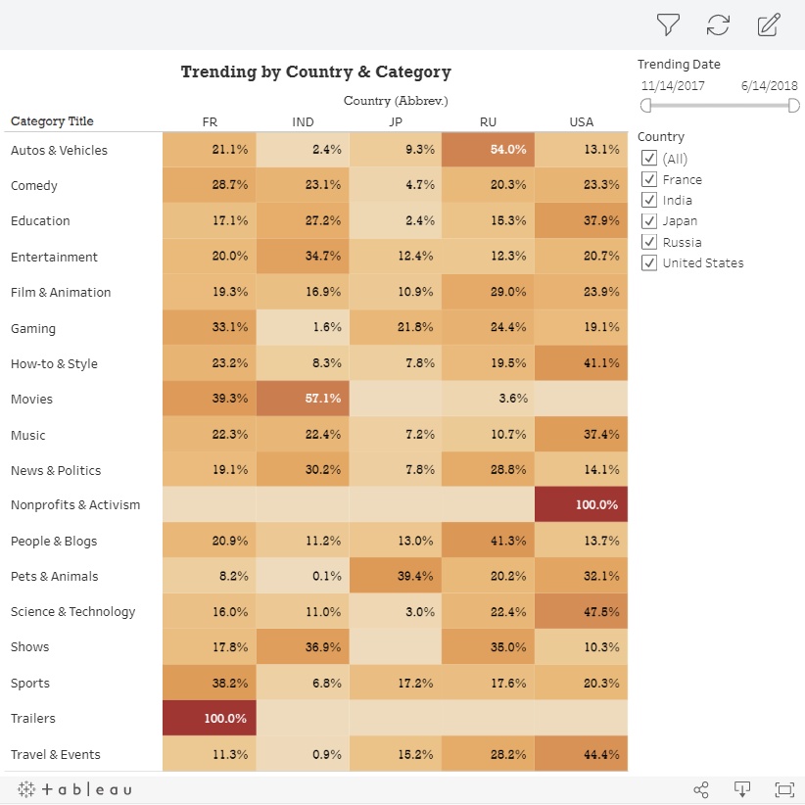
Russia & the USA have almost completely opposite video content preferences on YouTube
Geographical effects over trendiness
The USA is the only nation to create video content of the Nonprofits & Activism genre in YouTube. In the same way, France was the only nation to produce Trailers video content in YouTube.
Japan was the only region that haven’t created any video content of Shows. Along with the US, the two nations didn’t had a single created Movies video in YouTube.
Russia’s the leading publisher of Autos & Vehicles video content (54% of video in genre), as well as People & Blogs (41.3%). Their least published genre is the Movies genre (only 3.6%).
Japan’s the leading publisher of Pets & Animals video content (39.4%), while the next genre they grasp a big share of is the Gaming genre (21.8), though they only have the second highest share in that one. Their least published genres were Education (2.4%) and Science & Technology (3%).
India’s the leading publisher of Movies video content in YouTube (57.1%), as well as the Entertainment (34.7%), News & Politics (30.2%) and many more, as they are tied with France & Japan in most of the other genre’s, showing of similar content preferences generally. Their least published content was Pets & Animals (with a microscopic 0.1%), followed by Travel & Events (0.9%).
France’s leading published genre, besides Trailers video content that only exist there, are the Sports (38.2%), Gaming (33.1%) and Comedy (28.7%), even though they have a higher representation within the Movies genre, yet not a lead. Their least published content genre was Pets & Animals (8.2%).
The USA’s leading genres, besides their Nonprofits & Activism monopoly, are Science & Technology (47.5%), Travel & Events (44.4), and How-To & Style (41.1%). Their least published video content category was Shows (10.3%) and then Autos & Vehicles along with People & Blogs, with 13.1% and 13.7%, accordingly.

